Slide 1
Editing Workshop• December 2019
Notes:
Welcome and intro

Slide 2
Editing Workshop: Creating a Worker Wednesday Video
Colin Trubee, ODOT Videographer

Slide 3
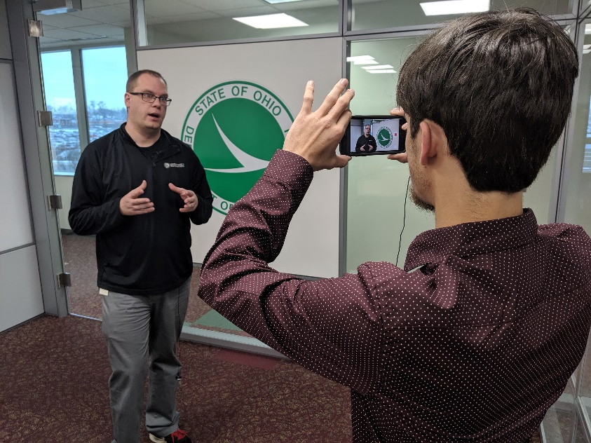
Filming An Interview
Tools you’ll need:
iPhone
Gorilla Pod (or a friend)
Rode SmarLav+
Extension Cable
Apple Lightning Adapter
Notes:
Show how to set everything up

Slide 4
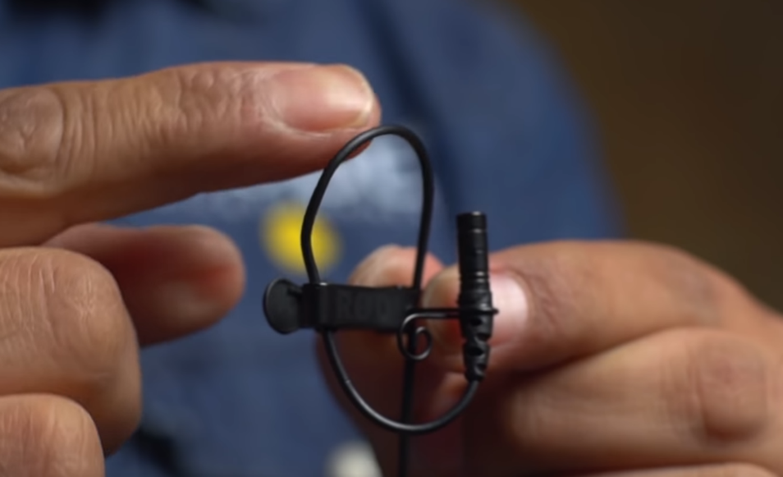
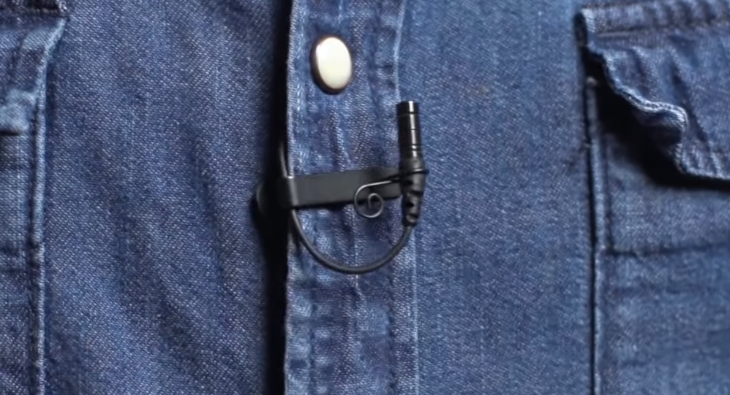
Filming An Interview
Lavalier Mounting Best Practices
Broadcast Loop
Mount around sternum of speaker
Notes:
Demonstrate how to make the broadcast loop
Wind noise? Get out your fuzzy windbuster!
Popping sounds from speaker? Flip upside down

Slide 5
Starting the edit: Getting Your Footage
Offloading footage from your iPhone
Plug into USB port on computer
Type in passcode
Tap “Trust/Allow”
Navigate folders (DCIM)
This PC>Apple iPhone>Internal Storage>DCIM>109APPLE

Slide 6
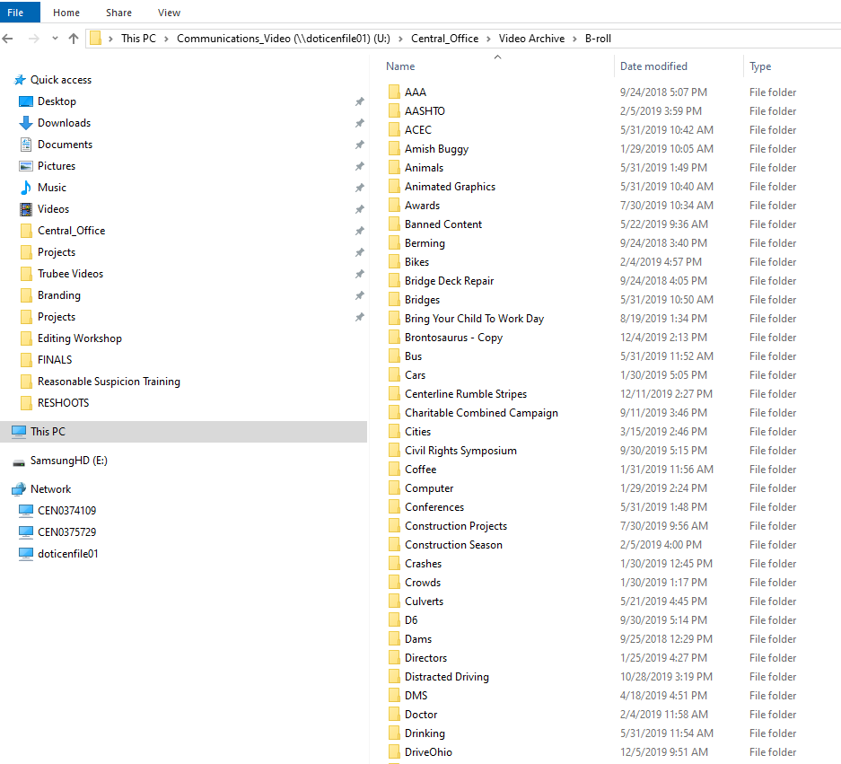
Starting the edit: Organizing Before Premiere
Utilize the Communications_Video Drive
Central_Office > Video Archive > B-roll

Slide 7
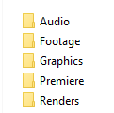
Starting the edit: Organizing Before Premiere
Create a folder for your project
Create subfolders
Footage, Audio, Graphics, Premiere, Renders
Copy videos into “Footage” folder
Open Premiere
Ctrl+Shift+N = New Folder
F2 = Rename folder
Notes:
Ctrl+Shift+N = New Folder
F2 = Rename folder

Slide 8
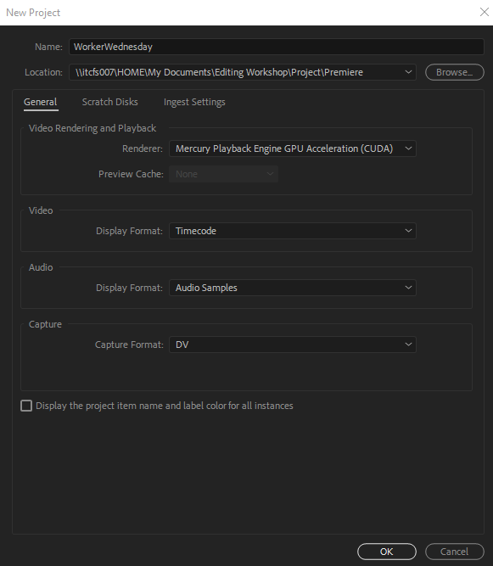
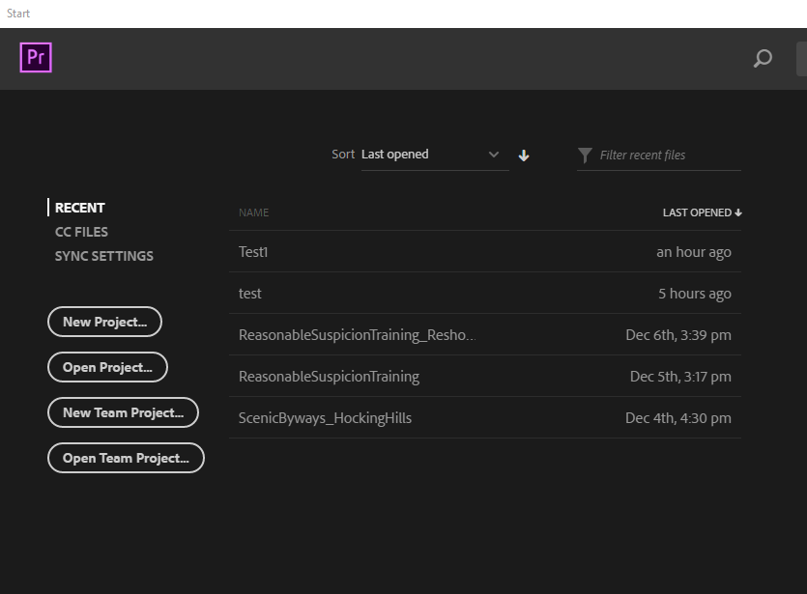
the edit: Creating a Premiere Project
Create a new Premiere Project
Locate the project in your Premiere folder with the Project folder

Slide 9
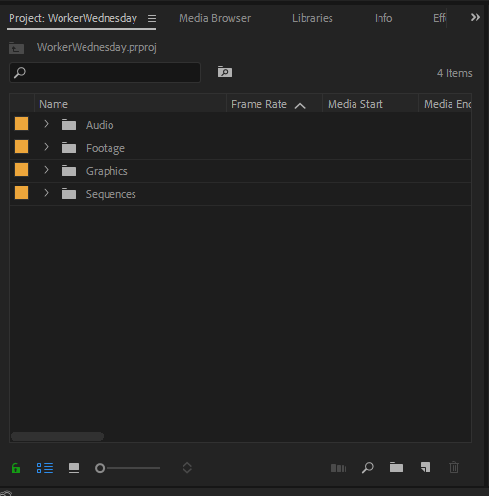
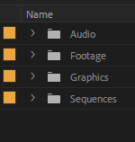
the edit: Setting up your Workspace
Navigate to “Editing” workspace
Create Labeled Bins (Bin Button or New > Bin)
Similar to folder structure
Footage, Audio, Sequences, Graphics, Sequences
Project
Panel
Bins
Notes:
Labelled Bins (Ctrl+B)
Media Browser keeps things organized. Allows you to preview clips before importing. Can accomplish importing with Ctrl+i

Slide 10
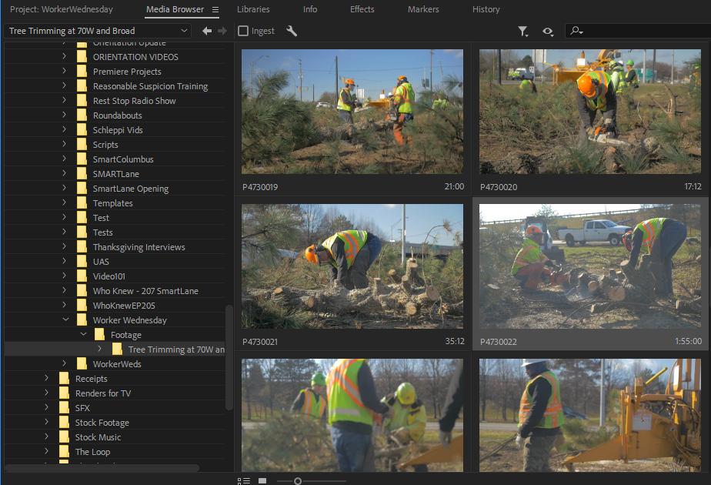
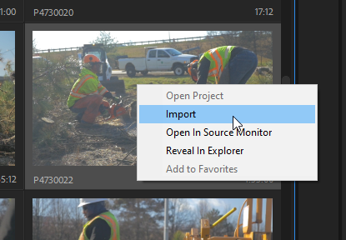
the edit: Importing your Footage
Import all footage via Media Browser
Right Click + Import
Move Clips to appropriate Bins
Create subfolders (Interview, Trimming)
Media Browser
Notes:
Labelled Bins (Ctrl+B)
Media Browser keeps things organized. Allows you to preview clips before importing. Can accomplish importing with Ctrl+I
Create bins within footage

Slide 11
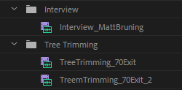
the edit: Organizing your Footage
Rename clips to make them easier to find
Makes footage searchable
Notes:
Makes content both searchable in sequence and bins
Ctrl+f in sequence

Slide 12
the edit: Creating your Sequence
Three Ways to do this:
File>New>Sequence
New Item Button
(Ctrl+n)

Slide 13
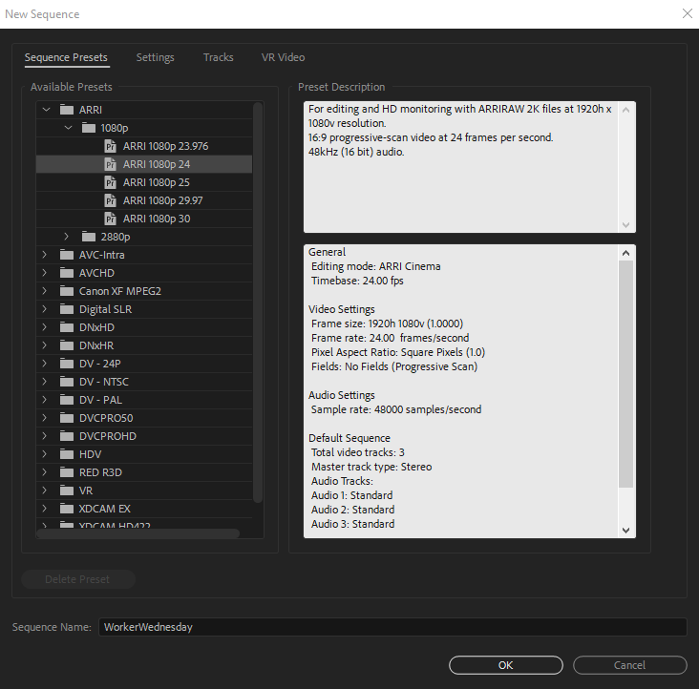
the edit: Creating your Sequence
Sequence Settings
ARRI >ARRI 1080p 24 or 23.96

Slide 14
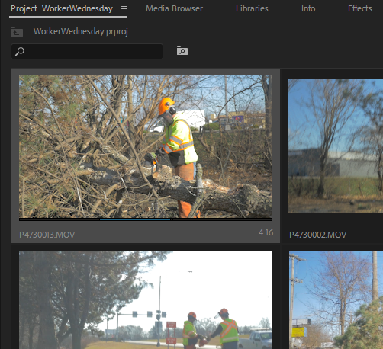
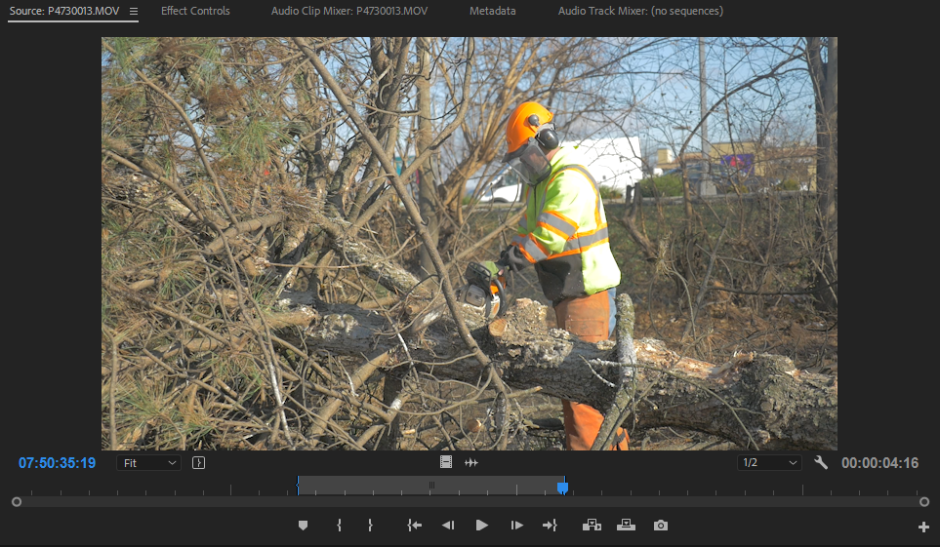
the edit: EDITING your Footage
Setting in and out points
Shortcut: “I” and “O”
Can set these in source monitor or in the bin
In (I) and Out (O)
In (I) and Out (O)

Slide 15
the edit: EDITING your Footage
Bringing footage into sequence
Drag from Project panel or Source Monitor
Click movie icon and drag for video only
Click audio icon and drag for audio only
“,”
Video
Audio

Slide 16
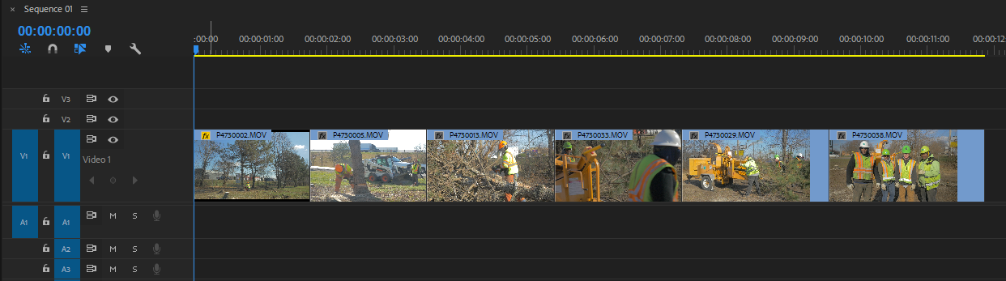
the edit: EDITING your Footage
Edit your sequence together!
Logical sequential order
Hint: Hold Alt and drag any clip to duplicate it

Slide 17
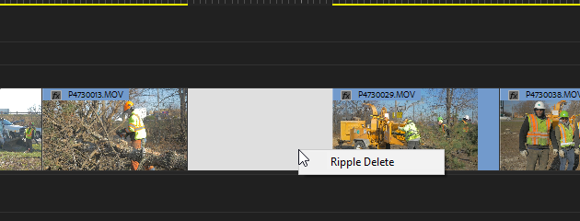
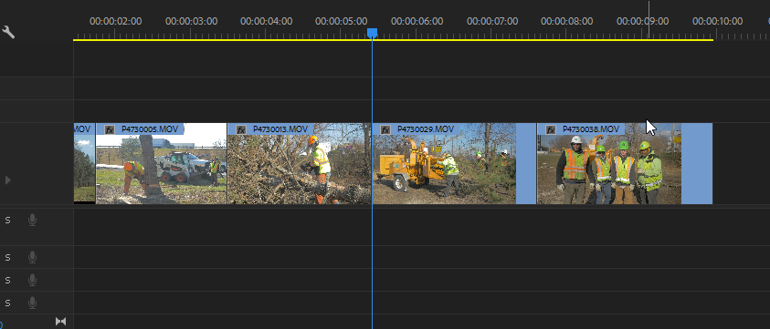
the edit: EDITING your Footage
Ripple Delete
Right Click or Shift+ Delete
After Ripple Delete

Slide 18
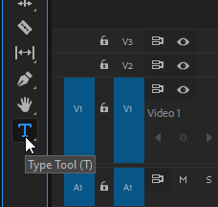
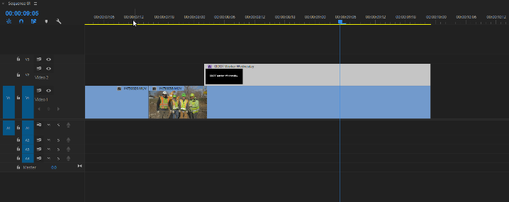
the edit: Adding a Title
Type Tool (T)
Adjust font, color, drop shadow in Essential Graphics Panel

Slide 19
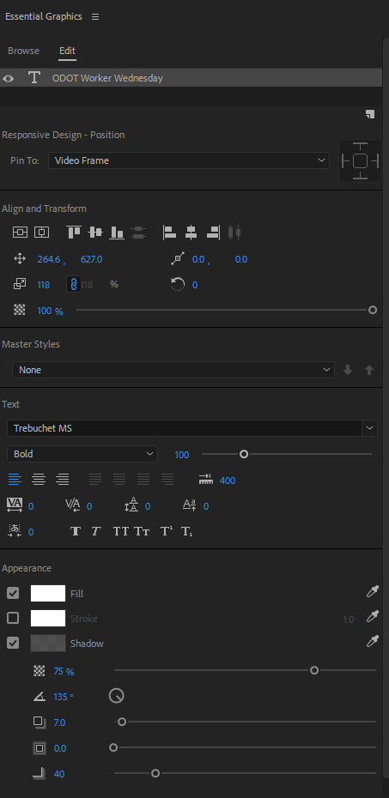
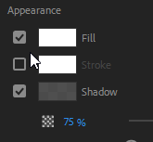
the edit: Adding a Title
Essential Graphics Panel
Window>Essential Graphics
Center Buttons
Color
Stroke
Drop Shadow

Slide 20
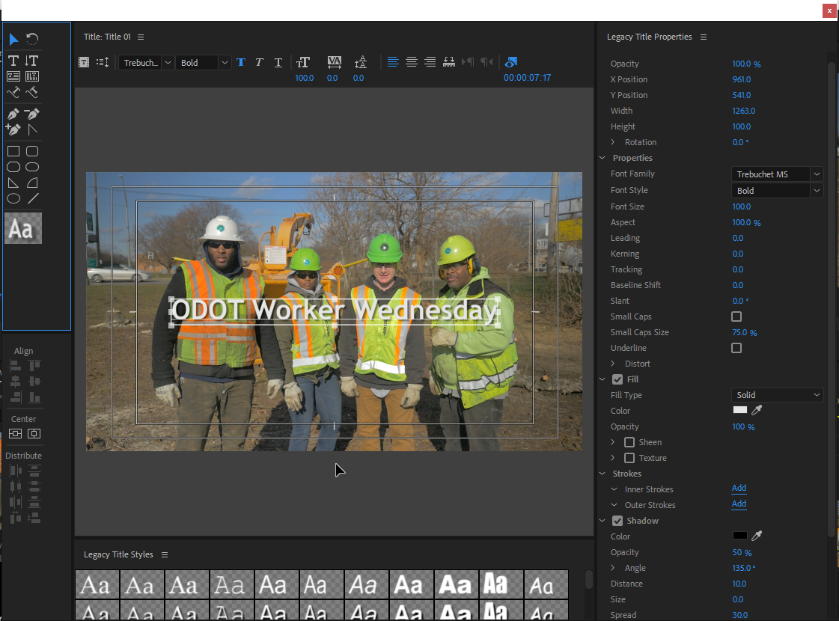
the edit: Adding a Title
Legacy Title
File>New>Legacy Title

Slide 21
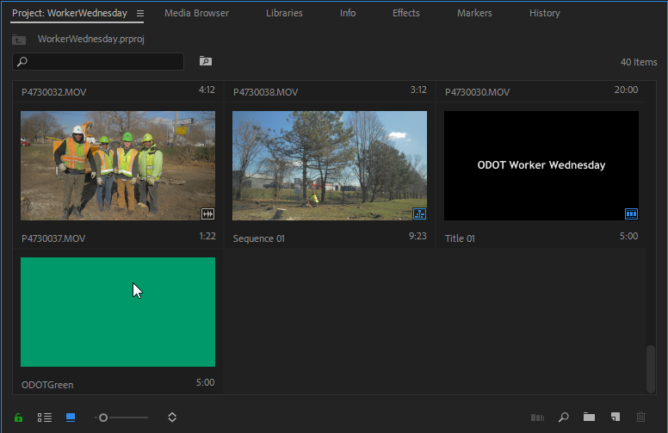
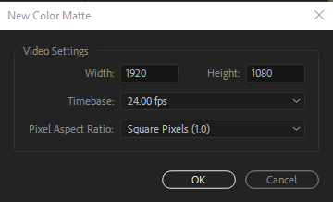
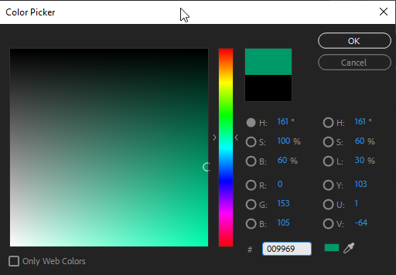
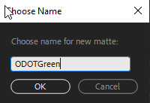
the edit: Adding a Title
Create a Color Background (Color Matte)
File>New>Color Matte
4
1
2
3

Slide 22
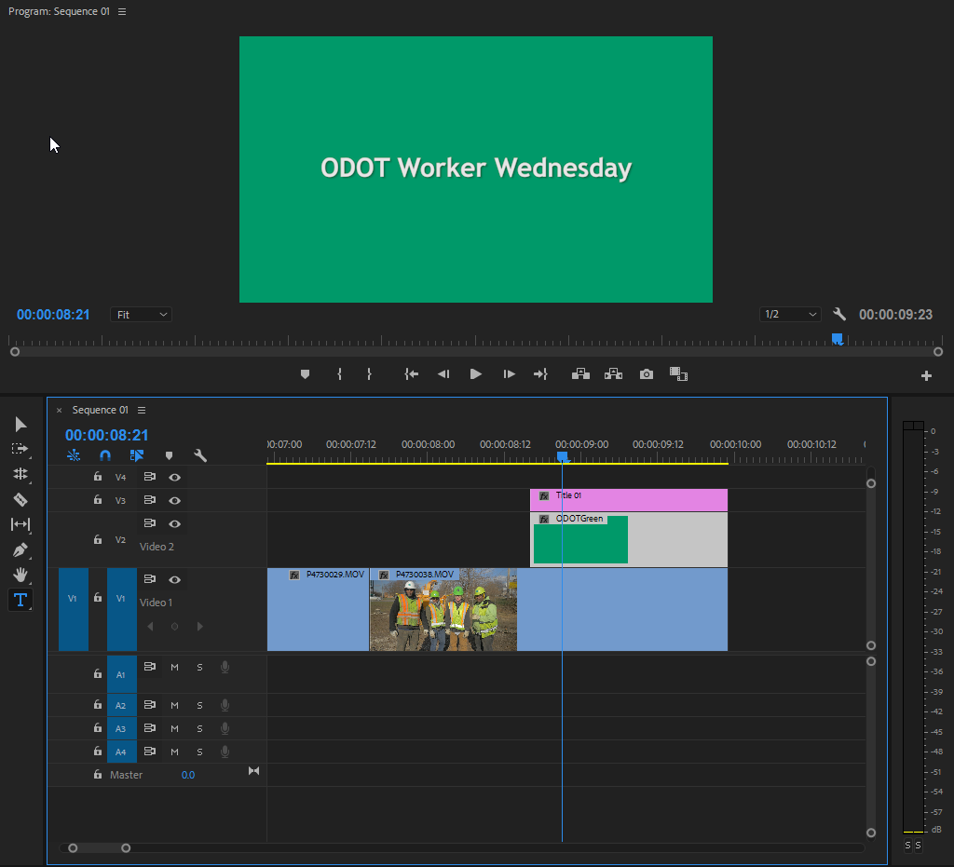
the edit: Adding a Title
Add color background to text
Drag onto sequence, underneath text layer

Slide 23
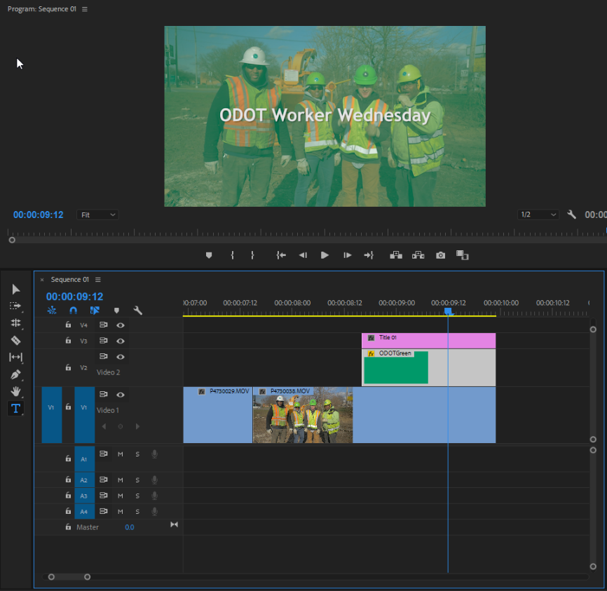
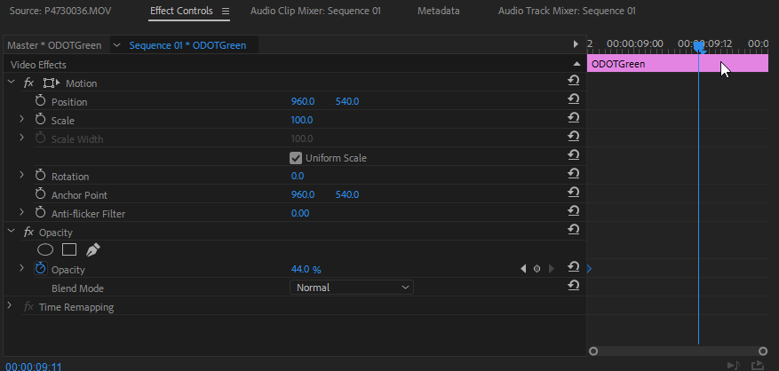
the edit: Adding a Title
Change opacity
Adjust opacity of color matte to see image below
Effect Controls

Slide 24
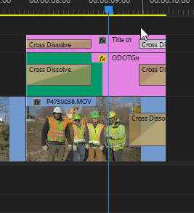
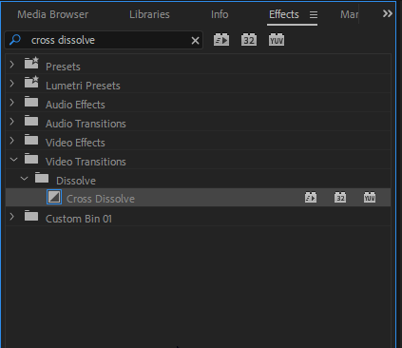
the edit: Transitions
Add a Cross Dissolve
Effects Panel and Search: Cross Dissolve
Ctrl+D

Slide 25
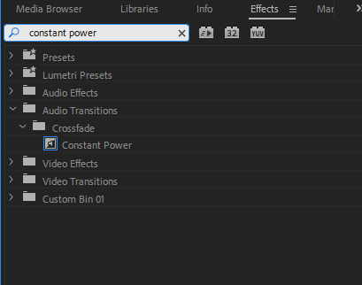
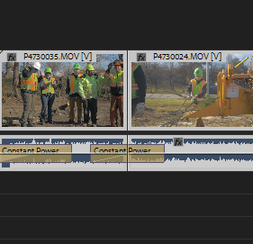
the edit: Smoothing Audio
Add a Cross Fade
Effects Panel and Search: Constant Power
Ctrl+ Shift+ D

Slide 26
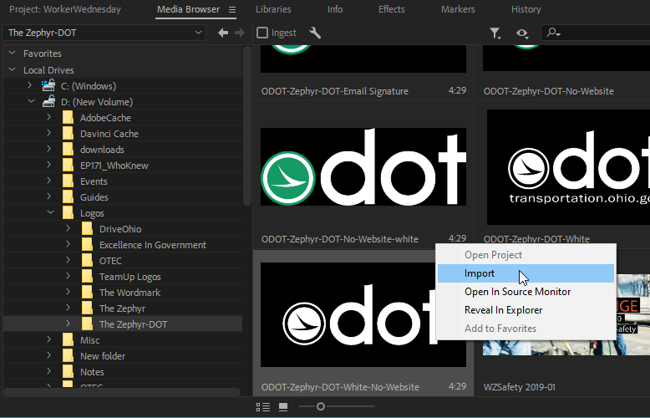
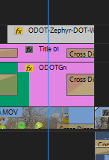
the edit: Add a Logo
Adding the Zephyr Dot
Import Logo in Media Browser
Drag onto sequence (Top Layer)
Resize and adjust Position in Effect Controls

Slide 27
the edit: Add a Logo
Adding the Zephyr Dot
Import Logo in Media Browser
Drag onto sequence (Top Layer)
Resize and adjust Position in Effect Controls

Slide 28
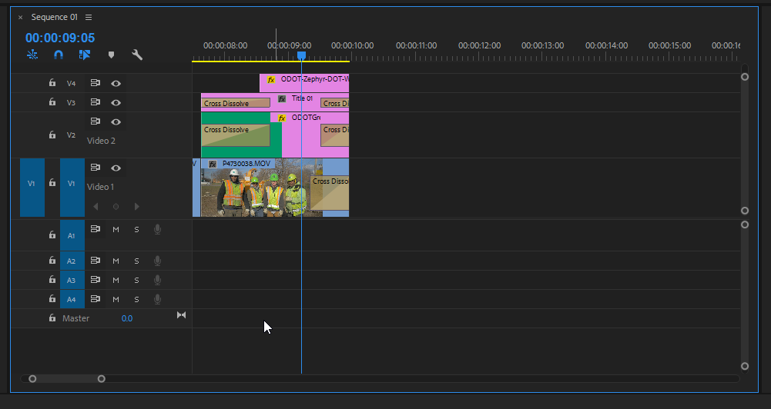
the edit: Rendering your video
Make sure Sequence is selected
Blue Outline
Click anywhere on sequence to select
File > Export > Media
Ctrl+M

Slide 29
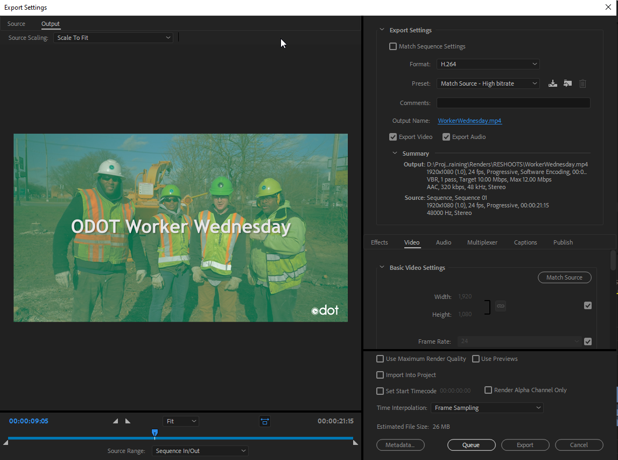
the edit: Rendering your video
Export Settings: H.264
Preset: Match Source – High bitrate
Output Name: WorkerWednesday_v1
Put this in Renders Folder within Project folder
Export: When exporting a single Video (Use 90% of the time)
Queue: When exporting multiple videos

Slide 30
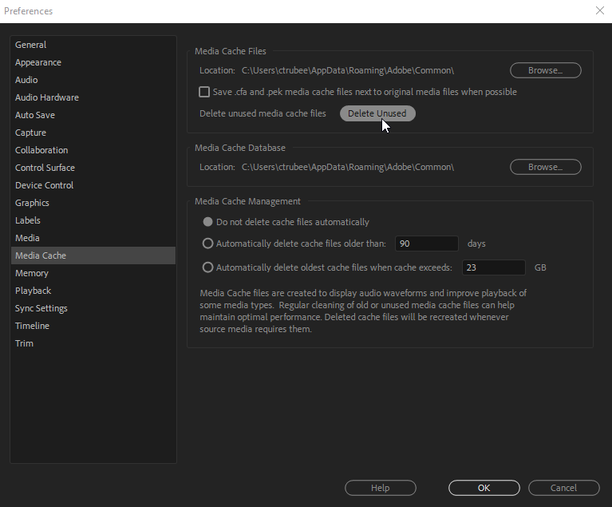
the edit: Rendering your video
Tips for Rendering
Only render to local drive! Not network drive!
Copy and paste to network afterwards
Close all other programs during render
Clear Media Cache
Edit>Preferences>Media Cache> Delete Unused

Slide 31
the edit: Check your Work
Watch your render
Check for typos
Gaps you didn’t see before
Effect glitches
If everything looks good then…

Slide 32
the edit: You did it!!!
Share that vid!

Slide 33
Questions
?
Last updated 12/16/2019

